Slide 1
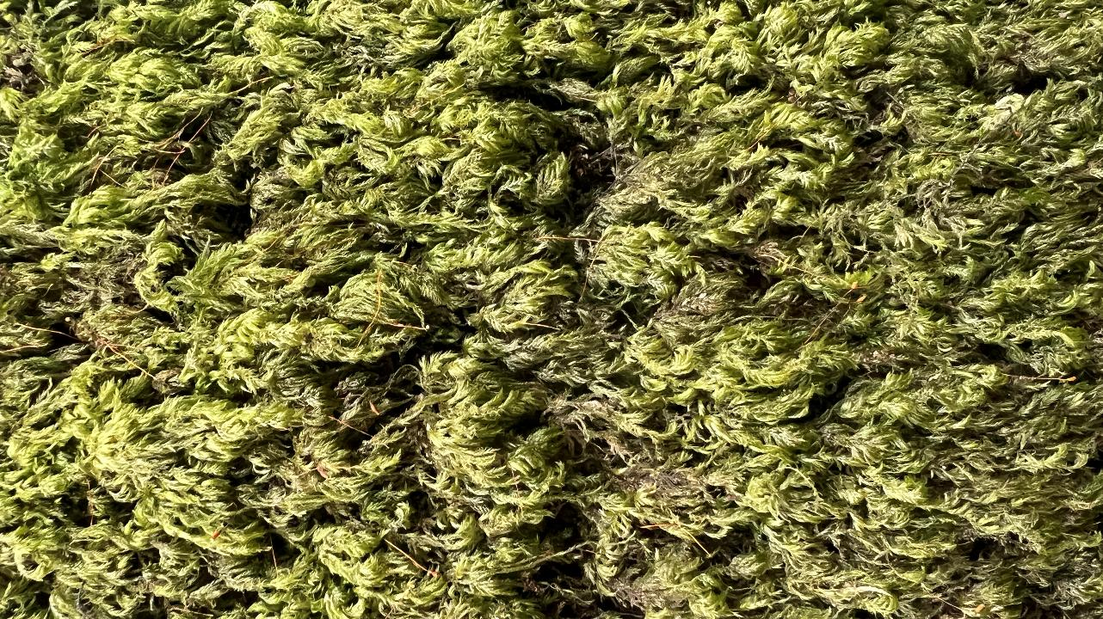
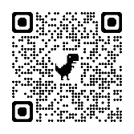

Moss Safari
A gateway to microscopy?
Dr. Andy Chandler Grevatt CSciTeach
Founder: Moss Safari
Association for Science Education Annual Conference
University of Nottingham, Friday 9th January 2026

Slide 2
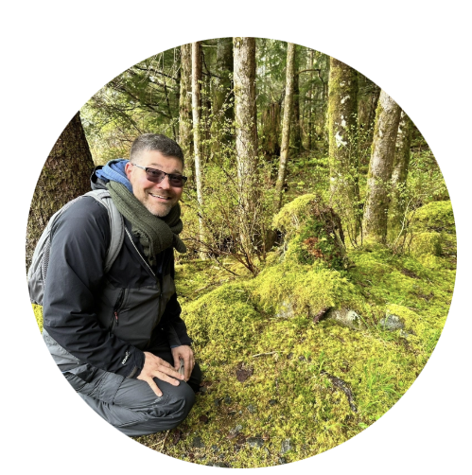
Introduction
Dr Andy Chandler-Grevatt
Teacher (CSciTeach), Author, Researcher
BSc (Hons) & MSc in Biological Sciences
Teacher: Secondary School Science teacher (10 years), University Lecturer in Science Education and Teacher Training (2006-).
Author: 96+ textbook / resource publications (OUP)
Research: Emotion needs of science teachers, Assessment in Science (EdD, 2010), teaching science
Founder, Moss Safari
Microscope and moss life enthusiast

Slide 3
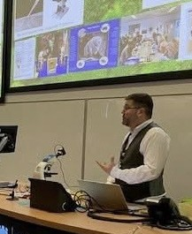
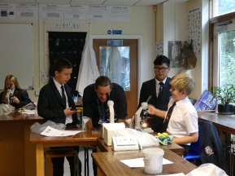
Session Outcomes
Participants will:
Understand the aims and opportunities for using Moss Safari in lessons or as an extracurricular activity.
Gain new subject knowledge that links key concepts in biological and environmental education to Moss Safari.
Obtain free resources to support teaching biological and environmental concepts through Moss Safari.

Slide 4
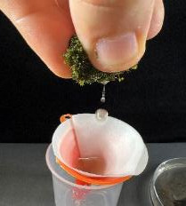
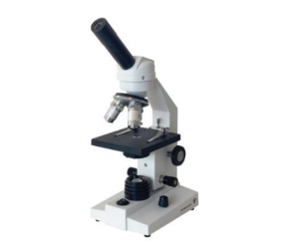
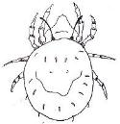





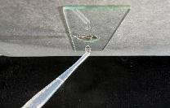
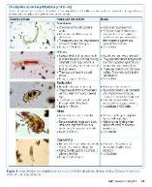
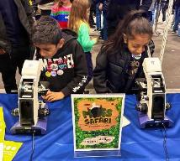
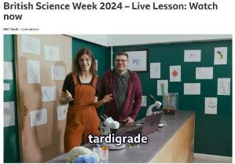
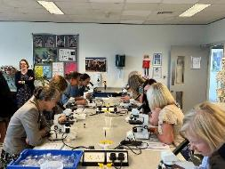
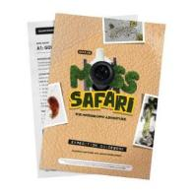
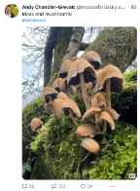
What is Moss Safari?
🌿 Connect with nature 🔬 Promote microscopy 🚀 Inspire STEM
“The simplest thing to do with a microscope”
Education
Collaboration
Accessible resources
Outreach in schools
Public engagement
Teacher support
The search for the microscopic Big Five (x40)
mite – nematode – rotifer – tardigrade – gastrotrich
Curriculum links and life stories (KS2-KS5)
The Moss Squeeze: Soak → Squeeze → Observe
Their lives in moss
→
In the ecosystem
→
Relevance to our lives

Slide 5
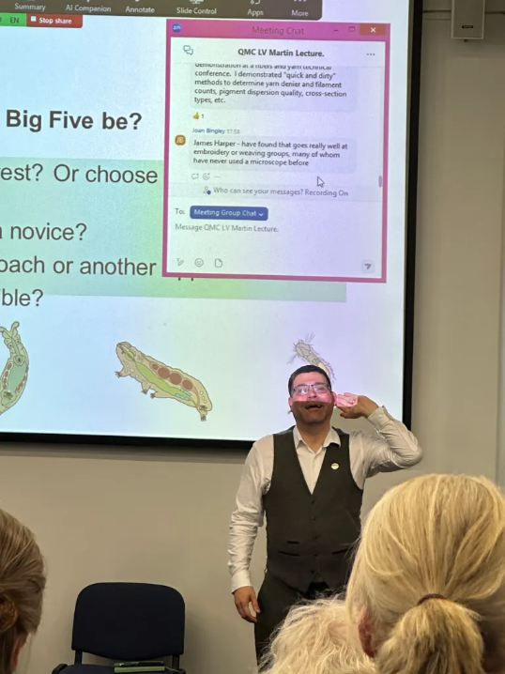
Moss Safari in 2025
Moss Safari directly engaged approximately 850 people through live events and outreach.
233 pupils and students
150 + teachers, technicians, and education professionals
400 + members of the public
28,800 views on www.mosssafari.com
hundreds of educational resource downloads.

Slide 6
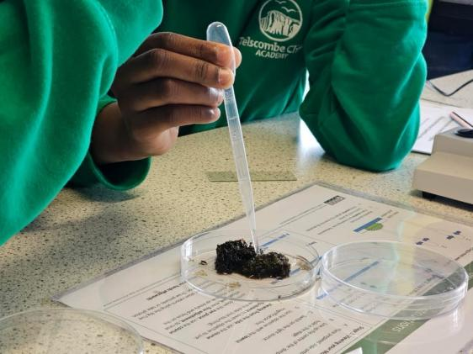
Moss Safari: the activity
Very simple
No staining
No specialised skills
No specialised techniques
Just - suck, squeeze, observe

Slide 7
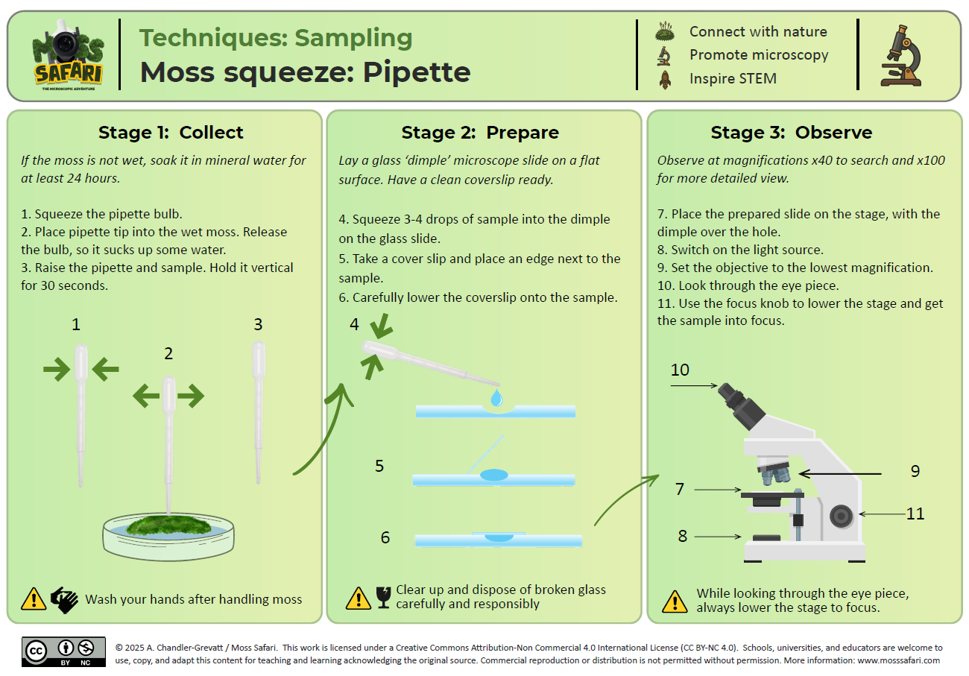
NEW
FREE
RESOURCES

Slide 8
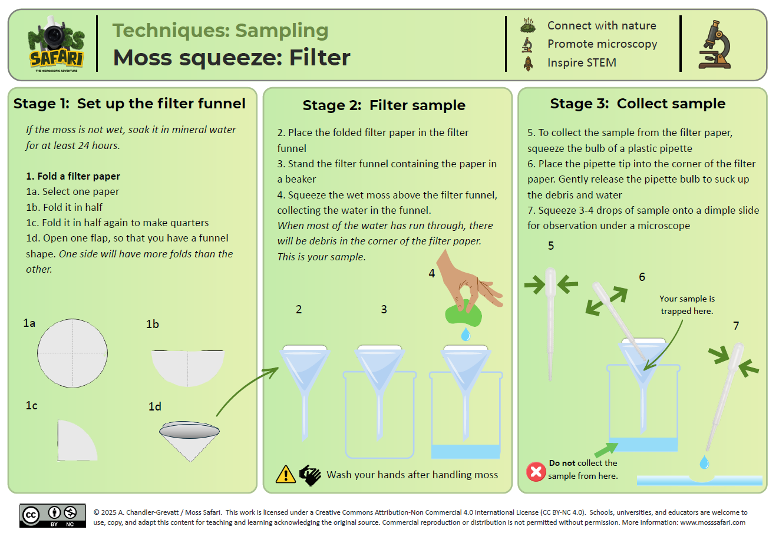
NEW
FREE
RESOURCES

Slide 9
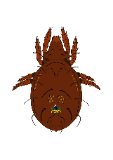
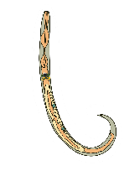
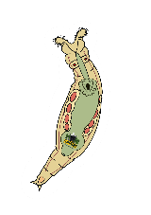
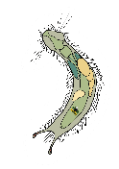
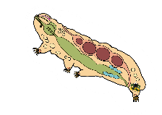
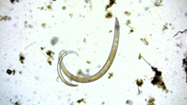
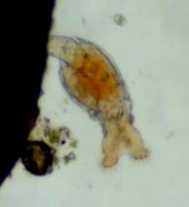
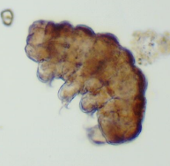
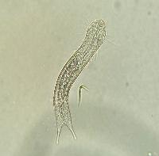
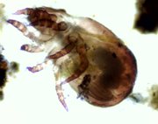
The microscopic Big Five
Oribatid mite
Nematode
Rotifer
Tardigrade
Gastrotrich

Slide 10
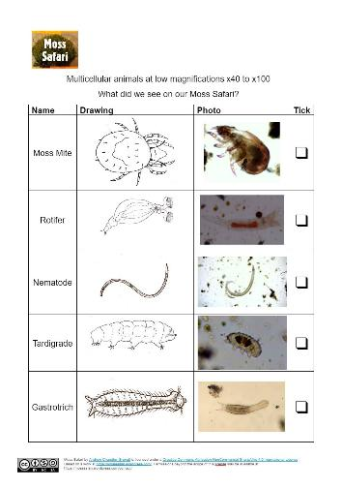
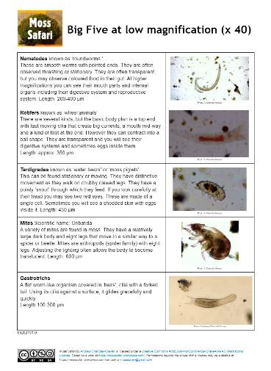
Microscopic Big Five Identification

Slide 11
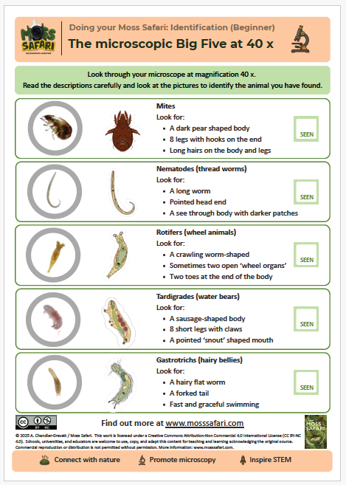
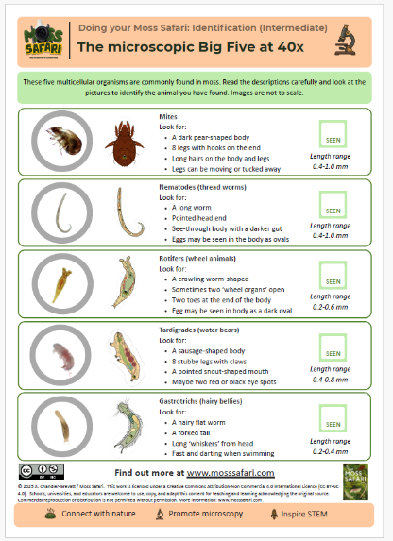
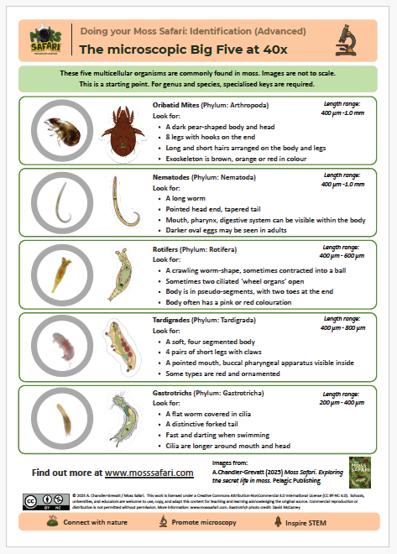
Microscopic Big Five Identification
NEW
FREE
RESOURCES

Slide 12
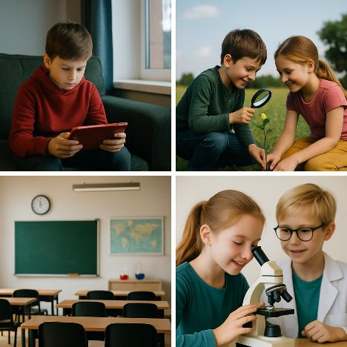
Current issues and challenges
Nature-Deficit Disorder
Plant Awareness Disparity
Declining practical work in secondary school
Barriers to using microscopes and microscopy
Declining and variable science capital in primary and secondary

Slide 13
Moss Safari Aims
🌿 Connect with nature
🔬 Promote microscopy
🚀 Inspire STEM

Slide 14
Learning Contexts
Curriculum
Primary
Microhabitats
Adaptation and change
Secondary
Evolution and natural selection
Cells
Single cells and multicellular
Microscopy
Curriculum-linked outreach
The search for a water bear (Primary)
Moss Safari: The science isn’t done (Secondary)
Moss Safari: How to survive in moss (T-levels)
Themes
Natural History
Climate Change
Biodiversity
Public – Family and Extra-Curricular
Open evenings / Open Days
Introduction to science days
Discovering Mosses
Moss Safari online: Family
What lives in moss?
Science Communication (undergrad)

Slide 15
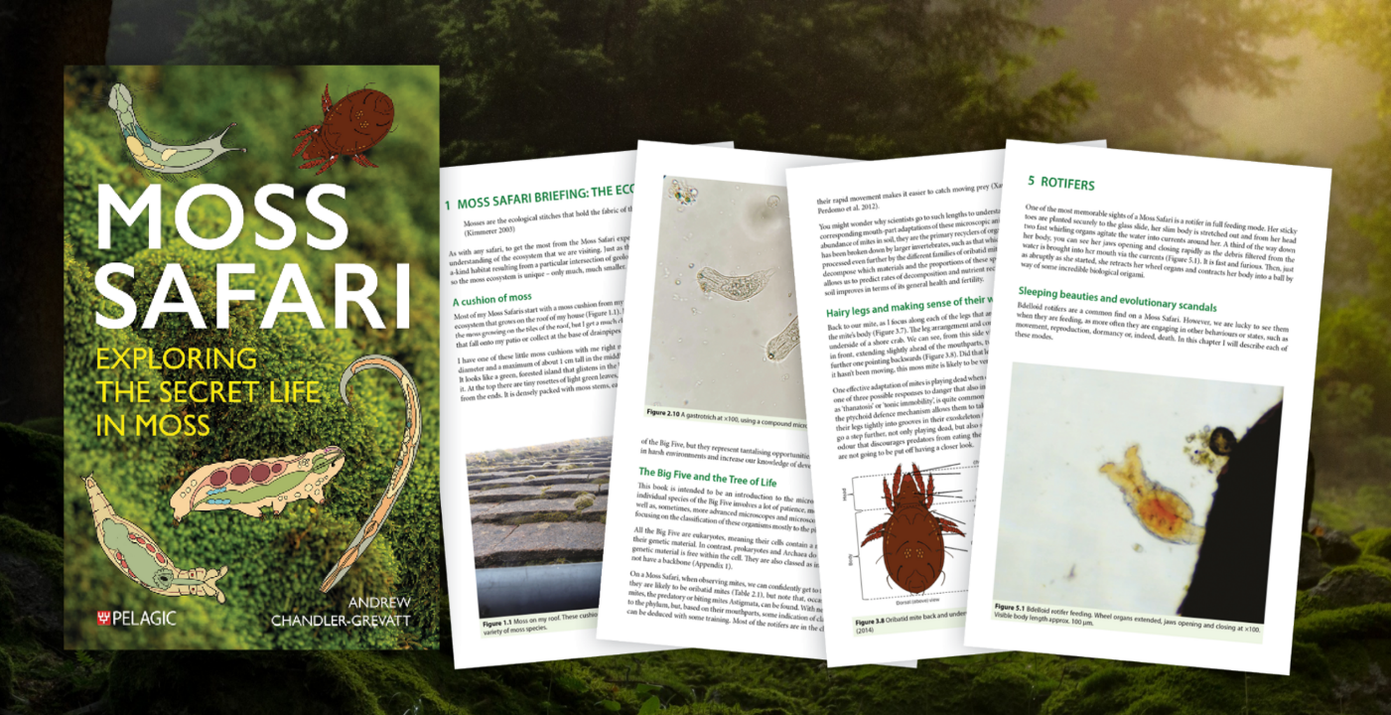

Slide 16
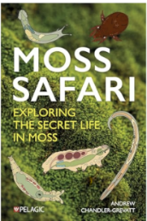
A journey through a micro-ecosystem
Moss Safari Briefing: The ecosystem
Mass Safari: Briefing: The Big Five Animals
Mites
Nematodes
Rotifers
Tardigrades
Gastrotrichs
Beyond the Big Five
Doing your own Moss Safari
Expedition Review
Perfectly balancing the practical and the inspiring, Moss Safari provides a travel guide for entering this miniature realm.
Dr Neil Bell, author of The Hidden World of Mosses

Slide 17
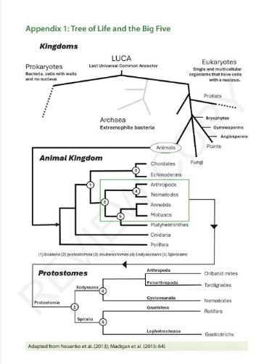
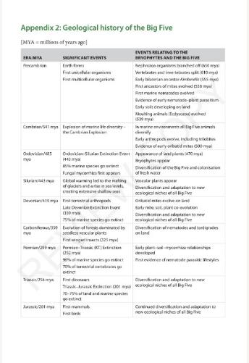
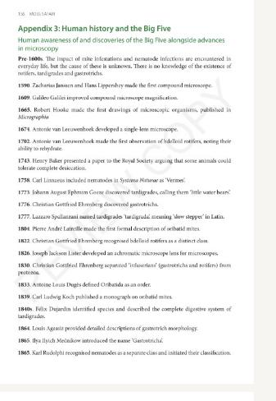
Themes
Chains, webs and cycles – interconnections
Relationships through time: evolutionary, geological and human

Slide 18
Developing themes
Oribatid mite
Nematode
Rotifer
Tardigrade
Gastrotrich
External to internal to biochemical and biomolecular
Organism level to ecosystem level
Highly understood to poorly understood

Slide 19
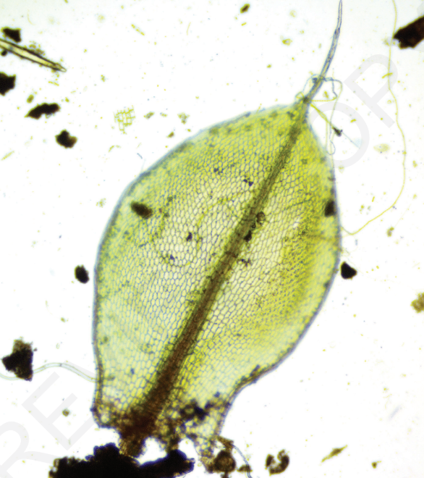
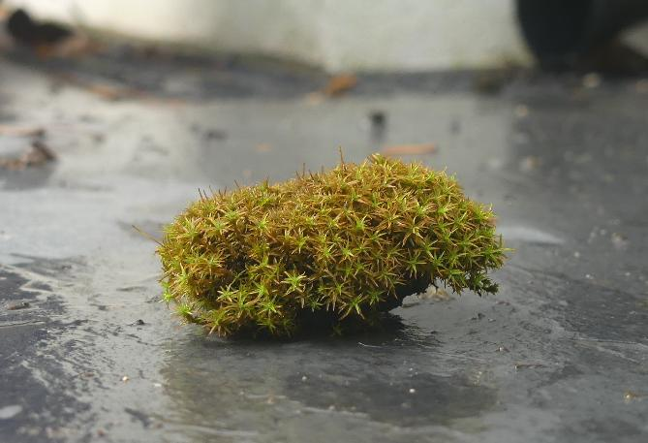
Moss: the terrain

Slide 20
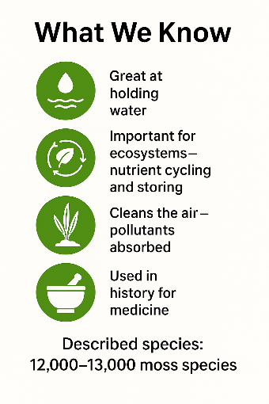
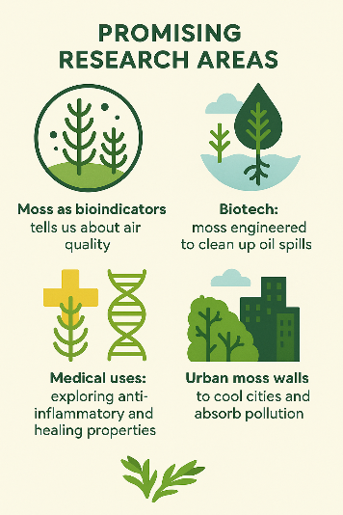
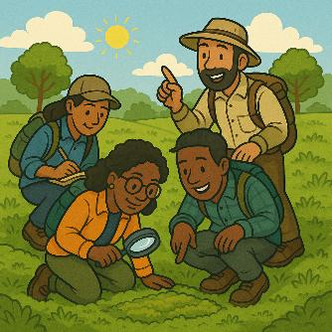
2,000 to 7,000 species may still be undiscovered or undescribed
The science isn’t done
AI Generated

Slide 21
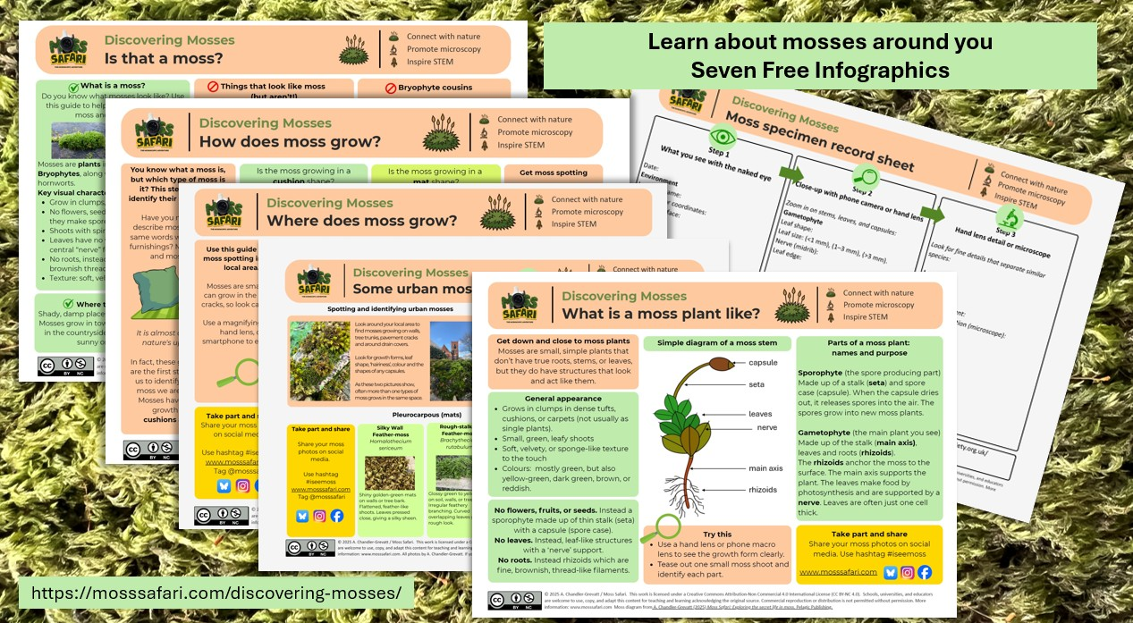
Discovering Mosses Series
NEW
FREE
RESOURCES

Slide 22
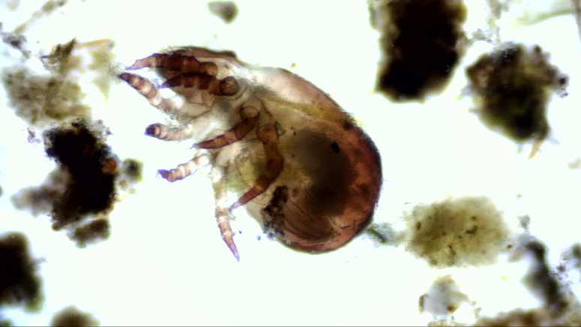
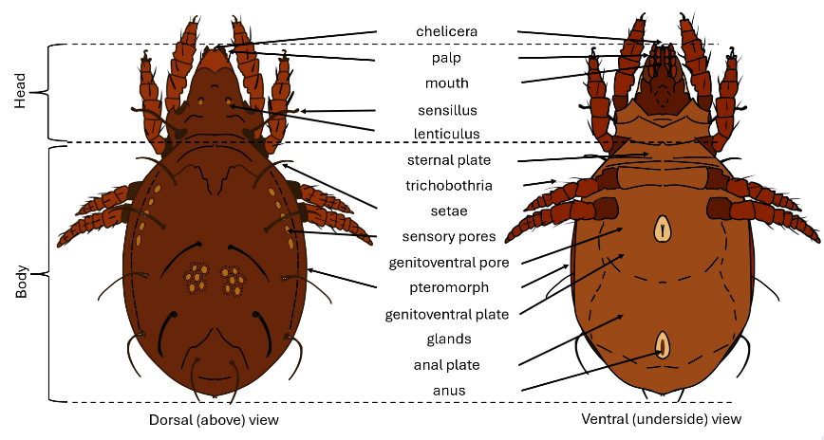
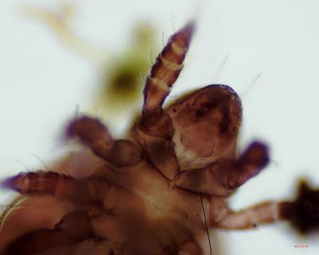
Mites in focus

Slide 23

Mite stories
Ecological significance through geological time
Soil – plant – mite co-evolution
Biodiversity explosions
Soil formation
Mycorrhizae appearance
Angiosperm Terrestrial Revolution
POINT OF INTEREST
Fossil evidence
Fossil evidence from around 538 million years ago
Hard bodies preserve well
Oribatid mites’ earliest relationships on land would have been with moss-like plants around 400 million years ago
The science isn’t done
Use as paleo-indicators and bio-indicators

Slide 24
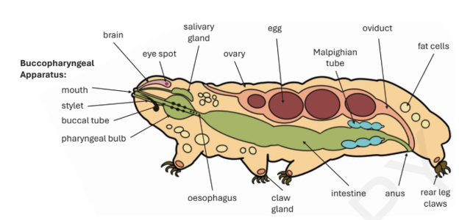


Body systems
Nematode
Rotifer
Tardigrade
Compare and contrast
Which organ systems do all three have?
Which organ systems are lacking? Why?
Source: Chandler-Grevatt, A. (2025) Moss Safari: Exploring the Secret Life in Moss. Pelagic Publishing.
Population → Organism → Organ systems → Cells → Molecules → Genes

Slide 25

Similarities between nematodes, rotifers and tardigrades
Level | What they share
Domain | Eukarya
Kingdom | Animalia
Body plan | Microscopic, multicellular, invertebrates
Supergroup | Protostomia
Ecology | Moss/soil/freshwater meiofauna
Lifestyle trait | Many can perform anhydrobiosis (cryptobiosis)
Source: Chandler-Grevatt, A. (2025) Moss Safari: Exploring the Secret Life in Moss. Pelagic Publishing.

Slide 26
Cryptobiosis: what is it?
"In cryptobiosis, animals like tardigrades, rotifers and nematodes lose almost all body water and enter a stable, ametabolic state, only resuming normal life when conditions improve."
Rebecchi (2013)
Cryptobiosis is a reversible, near-death state where an organism’s metabolism becomes almost zero, allowing it to survive extreme stresses such as desiccation, freezing or low oxygen.
Population → Organism → Organ systems → Cells → Molecules → Genes

Slide 27




One challenge: Three solutions
Nematode
Rotifer
Tardigrade
Rotifer tun
~ 70–250 µm
Tardigrade tun
~ 100–400 µm
Nematode dauer
~0.6–1.0 mm
Population → Organism → Organ systems → Cells → Molecules → Genes

Slide 28
Cryptobiosis
Population → Organism → Organ systems → Cells → Molecules → Genes
Nematode
Rotifer
Tardigrade
Dauer only occurs at a specific larval stage.
Whole-body metabolism slows dramatically but can resume within minutes to hours after rehydration.
Can lose up to 97% of body water.
Internal organs shrink and metabolism falls to near zero.
Usual: months
Record: 42,000 years
Usual: months
Record: 24,000 years
Average: months
Record: 30 years

Slide 29

Cryptobiosis
Population → Organism → Organ systems → Cells → Molecules → Genes
How do macromolecules work together to protect different parts of the cell?
Cell membrane(s)
Organelles
Cytoplasm
DNA
Rebecchi, L., Boschetti, C. & Nelson, D.R. (2020) ‘Extreme-tolerance mechanisms in meiofaunal organisms: a case study with tardigrades, rotifers and nematodes’, Hydrobiologia, 847(12), pp. 2779-2799. doi:10.1007/s10750-019-04144-6

Slide 30



Nematodes in focus

Slide 31


Nematode stories
Huge relative biomass globally
Wild mammals (0.007 Gt C), nematodes (0.02 Gt C), humans (0.06 Gt C)
For each human, there are 60 billion nematodes living in the soil
POINT OF INTEREST
Organisms from all five kingdoms are represented in moss
bacteria, protists, animals, plants, fungi

Slide 32


Nematode stories
C. elegans is a model organism
First organism to have its genome and connectome sequenced.
Has ‘won’ three Nobel prizes incl. death genes
The science isn’t done
Approx 25,000 species described
Estimated 40,000 to 1 million yet to be described or discovered
The science isn’t done
Learning ability - shocks
Distinguishing colour
without eyes
Notes:
The nematode Caenorhabditis elegans, a well-studied model organism, has a genome of approximately 100 Mb.

Slide 33

Nematode stories
The science isn’t done
Learning ability - shocks
Distinguishing colour
without eyes
Extreme survival and colonisation
General life cycle: 3-4 days
General life expectancy: 2-4 weeks
Dauer
Extreme survival 42,000 years

Slide 34



Rotifers in focus

Slide 35

Rotifer stories
Evolutionary Scandals
No males (Bdelloids)
Parthenogenesis
How do they deal with changing selective pressures?
POINT OF INTEREST
Horizontal Gene Transfer
Up to 10% of the rotifer genome appears to be from other organisms, a proportion much higher than in any other animal in which HGT is seen.
It is thought that this is the factor that has helped rotifers build up a set of genes that increases immunity to attack by pathogens.
The science isn’t done
We're still investigating how HGT works in bdelloids, why it's so prevalent in them, and how it affects their evolution and ecology.

Slide 36





Change and Adapt: Rotifers and Microplastics
Rotifers
Around 2,200 species.
Most live in freshwater, but some are marine.
Most around 0.5 mm in length.
Distinctive adaptations: ‘corona’ and ‘trophi’ involved in filter feeding.
They can filter 100,000 times their own volume of water per hour.
Microplastics
Microplastics (MPs) are one micrometre long or less.
Sources: tyres, washing clothes, sewerage, plastic pellets used to make plastic items etc.
Impact: bioaccumulation in food chains, in marine life - blocks digestive systems, reduces reproductive success, harms soil health.
Case of microplastics and marine rotifers
When there are microplastics in the sea, marine rotifers accidently breakdown MPs into nanoplastics (NPs).
Impact of NPs on rotifers
The smaller the particle, the greater the uptake into the rotifer’s body.
Smaller particles have greater negative effects on rotifer life cycles including growth rate, digestion and reproductive success.
And a negative effects on future generations.
Li et al (2023)
Yu et al (2024)
Adaptions to plastic
Rotifers recover if grown in clean water
Wang et al (2023)
Plastic degrading bacteria found in the environment and the in guts of marine worms.
Zhao (2024)
The plastisphere
Microbes and meiofauna are colonising the plastisphere.
Bacteria, viruses, algae and tardigrades. Ecological change will occur, we are not sure how or to what extent.
Lacerda et al (2024)

Slide 37



Tardigrades in focus

Slide 38


Tardigrades stories
Tardigrade survival
Extreme conditions in natural and experimental
Tun formation
Cryptobiosis: biochemistry –abundant heat soluble (AHS) proteins and Dsup proteins
POINT OF INTEREST
Sleeping Beauty or the Picture of Dorian Gray?
Rotifers and tardigrades are sleeping beauties.
The science isn’t done
AHS proteins hold promise in vaccine stabilisation.
Tardigrade genes in human cells show increased tolerance of ionising radiation… what next?

Slide 39



Change and Adapt: Urbanisation of tardigrades
Tardigrades
Less than 1 mm in length.
Live mostly in moss and lichens.
Some species can survive extreme conditions in their tun state.
Urban areas
Cities have high levels of pollutants including
Several tardigrade species can survive in moss and lichen in cities.
Common pollutants
Gases – nitrogen oxides, carbon dioxide /monoxide, ozone, heavy metals, oil and grease, microplastics, industrial chemicals, pesticides, and herbicides.
Urban sludge
An artificial substrate made up of urban waste.
de Albuquerque et al (2018)
Urbanisation
Human population:
>6000 billion by 2045
Urban areas are expanding significantly.
Urbanised animals include pigeons, foxes, sea gulls, squirrels are adapted to survive in cities.
Are tardigrades becoming urbanised?
It appears that there are some tardigrade species only found in urban substrates.
Gonzalez-Reyes et al (2000)
Case study in Salta City, Argentina.
Monitoring biodiversity and abundance of urban tardigrades.
The impact of an anthropause
COVID-19 Lockdown
During the anthropause, the species diversity and abundance of tardigrades increased in all 3 traffic areas.
González-Reyes et al (2024)
Traffic | Biodiversity | Abundance
Low | High | Medium
Medium | Medium | Medium
High | Low | High

Slide 40


Gastrotrichs in focus
Photo: David McCamey

Slide 41

Gastrotrich stories
Resting eggs
Three standard eggs and one resting egg as insurance.
Resting eggs can only be produced through sexual reproduction.
The science isn’t done
Gastrotrichs are:
Hard to catch
Hard to preserve
Hard to identify
and leave no trace

Slide 42


Moss Safari: What Next?
Share the secret
Word of mouth
‘Have you seen this?’
Subscribe free
www.mosssafari.com
Social media
Shares, comments, likes, pictures
Recommend to schools, clubs, team building
Get the book!
Contact me
www.mosssafari.com
Dr Andy Chandler-Grevatt
a.chandlergrevatt@brighton.ac.uk
🌿 Connect with nature 🔬 Promote microscopy 🚀 Inspire STEM

Slide 43


Feedback and thoughts?
THANK YOU
WEBLINK TO SURVEY
Dr Andy Chandler-Grevatt
a.chandlergrevatt@brighton.ac.uk

Slide 44

GALLERY
Questions?

Slide 45


Moss Safari Merchandise

