Slide 1

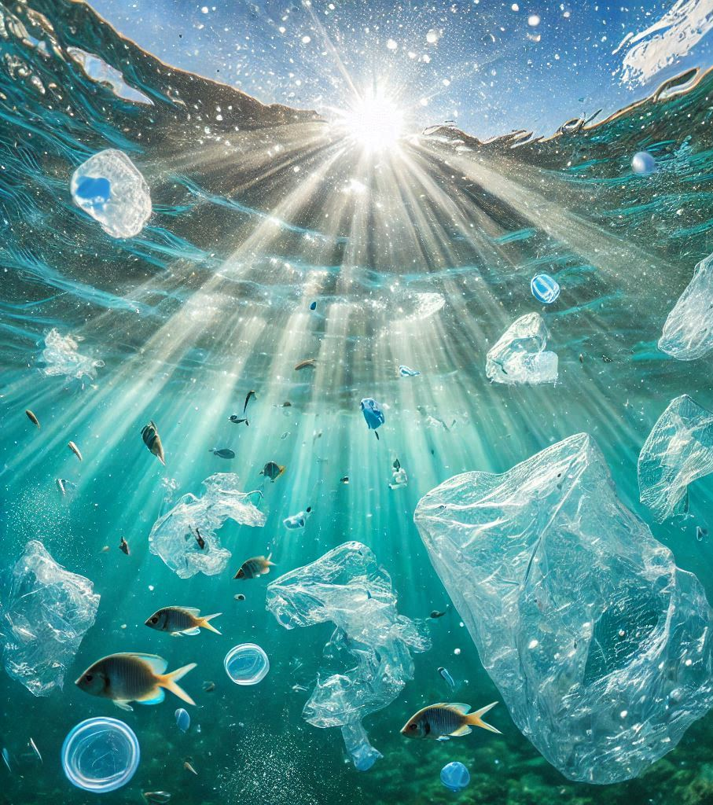
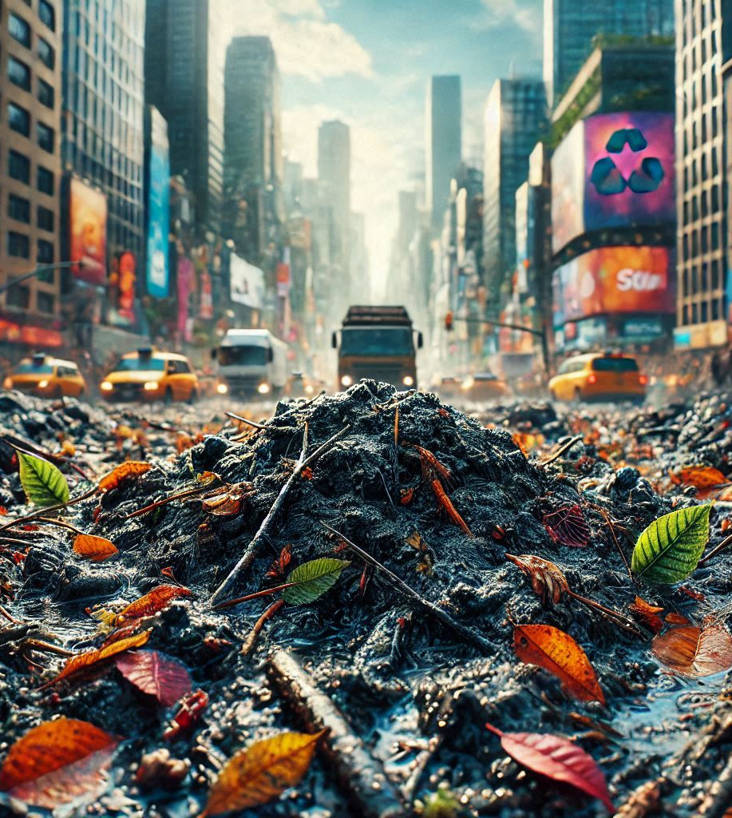
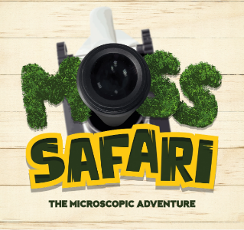

Change and Adapt:
British Science Week Special
Images generated by AI
www.mosssafari.com

Slide 2
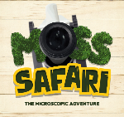
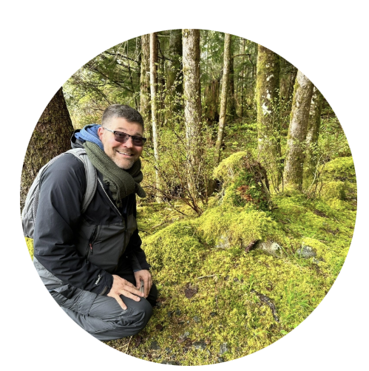
Welcome to Moss Safari ASE 2025
What is Moss Safari?
British Science Week 2025
Change and Adapt 1
  Moss and Climate Change
Change and Adapt 2
  Rotifers and microplastics
Change and Adapt 3
  Urbanisation of tardigrades
Resources
Next Steps
Dr Andy Chandler-Grevatt, aka Dr Moss
Notes:
Come on microscopic adventure through a microscope and learn how moss offers solutions to climate change, rotifers deal with microplastics, and how tardigrades have become urbanised.
Moss Safari is an increasingly popular activity and having featured in the BBC Live Lesson in 2024 more primary and secondary school teachers are doing Moss Safari’s as part of their curriculum or extra-curricular activities.
Get ready for your Science Week in March 2025 or primary to secondary transition activities by attending this live Moss Safari session with a focus on ‘Change and Adapt’ the British Science Association’s focus for British Science Week.
Andy (Dr Moss) will take you on a live Moss Safari and tell you the stories of how three of the Big Five have changed and adapted over geological time and are adapting (or not) to urbanisation, climate change and environmental pollution.
Delegates will enjoy a fascinating adventure exploring a sample of moss for the Big Five microscopic organisms, learn novel practical approaches to microscopy, and curriculum linked subject knowledge.

Slide 3
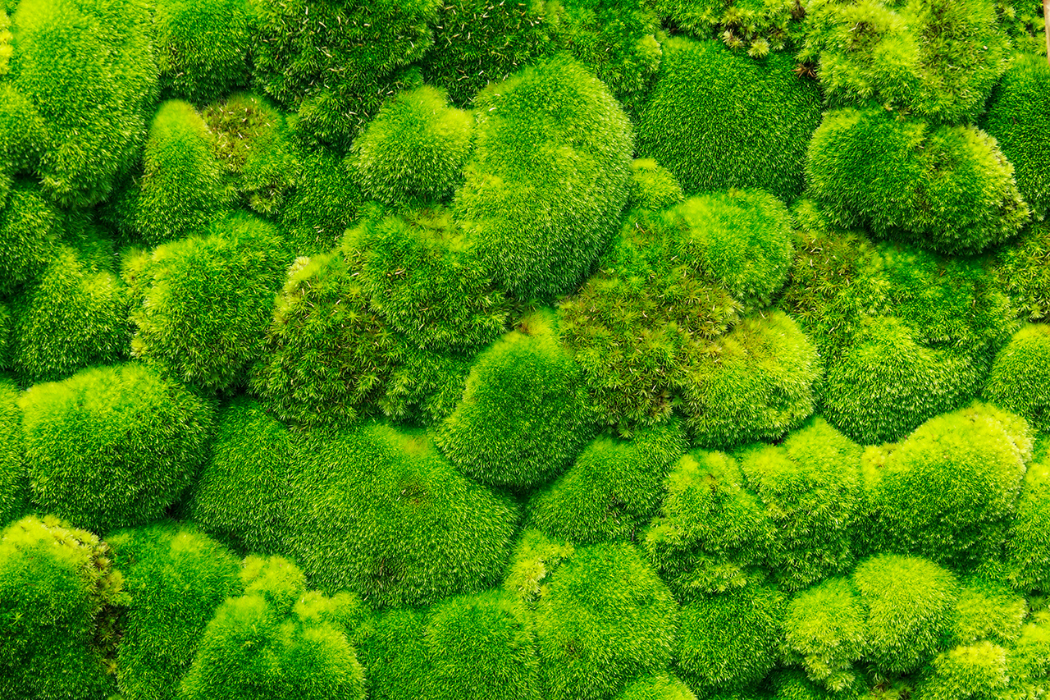
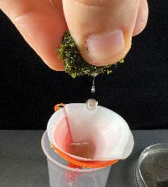
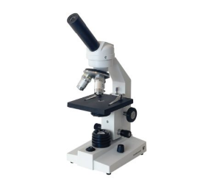
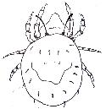




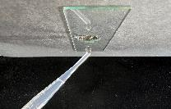
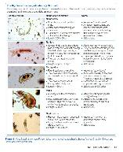
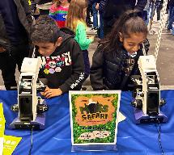
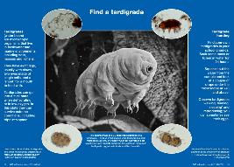
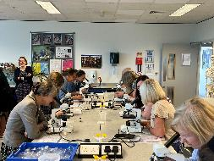
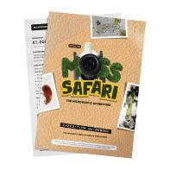
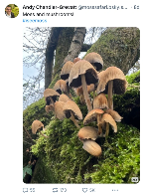
What is Moss Safari?
“I’ll never look at moss in the same way again”
“The simplest thing to do with a microscope”
Aims
Engagement with nature.
Promoting microscopy and making it accessible to all.
Inspire everyone to do STEM hobbies and careers.
The search for the microscopic Big Five (x40)
Education
Collaboration
Accessible resources
Outreach in schools
Public engagement
mite – nematode – rotifer – tardigrade – gastrotrich
Curriculum links and life stories (KS2-KS5)
Their lives in moss
→
In the ecosystem
→
Relevance to our lives
The Moss Squeeze: Soak → Squeeze → Observe

Slide 4
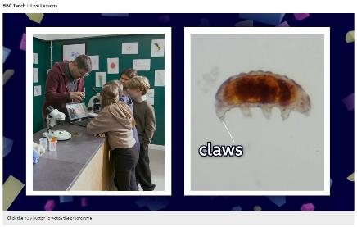
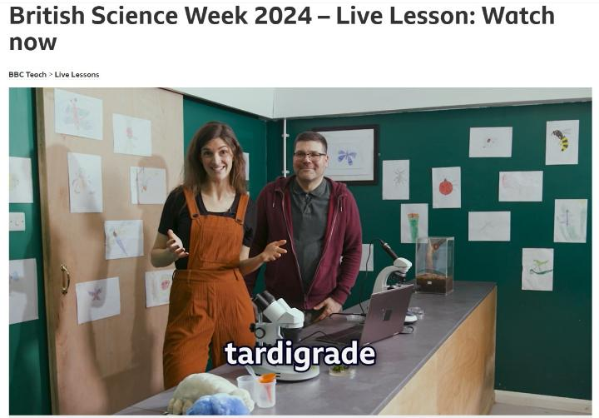
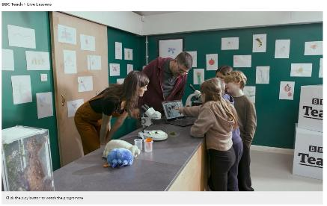
BBC Live Lesson: British Science Week 2024

Slide 5

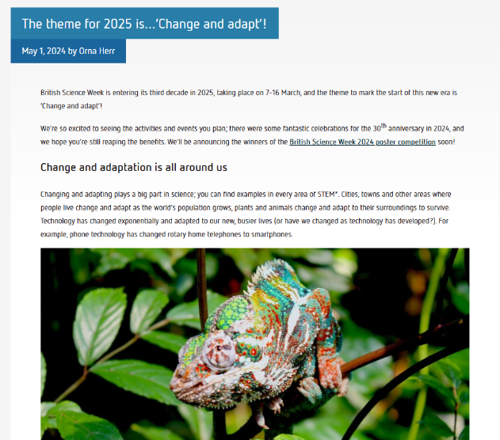

Click QR code to go to
British Science Week website

Slide 6

Big 5 Adapt and Change over Geological Time
Pre-Cambrian
Cambrian (~541–485 mya)
Ordovician (~485–443 mya)
Silurian (~443–419 mya)
Devonian (~419–359 mya)
Carboniferous (~359–299 mya)
Permian (~299–252 mya)
Triassic (~252–201 mya)
Jurassic (~201–145 mya)
Cretaceous (~145–66 mya)
Paleogene (~66–23 mya)
Neogene (~23–2.6 mya)
Quaternary (~2.6 mya–Present)
Rotifers (600 mya)
Nematodes, Tardigrades, Gastrotrichs (500 mya)
Cambrian explosion
Mosses (450 mya)
Oribatid mites (400 mya)
Ordovician-Silurian Extinction
First soils (500-450 mya)
Ordovician Biodiversification
Late Devonian Extinction
Devonian Radiation
Carboniferous Radiation
Permian-Triassic Extinction
Triassic-Jurassic Extinction
Mesozoic Marine Revolution
Flowering plant revolution (66 mya)
Cretaceous-Paleogene (K-Pg) Extinction
Group | Recorded Species | Estimated Species
Oribatid Mites | ~10,000 | ~100,000–200,000
Nematodes | ~25,000 | ~1,000,000+
Rotifers | ~2,000 | ~10,000
Tardigrades | ~1,300 | ~10,000
Gastrotrichs | ~800 | ~4,000–5,000
Cenozoic Mammal Radiation
Notes:
Ordovician-Silurian Extinction (~443 mya)
Caused by rapid cooling and glaciation, leading to a drop in sea levels and the loss of marine habitats.
Late Devonian Extinction (~372–359 mya)
Likely caused by environmental changes such as anoxia (low oxygen levels) in oceans, affecting marine species.
Permian-Triassic Extinction (~252 mya)
Known as the "Great Dying," it wiped out over 90% of species due to massive volcanic eruptions, climate change, and ocean acidification.
Triassic-Jurassic Extinction (~201 mya)
Likely caused by volcanic activity, climate shifts, and rising carbon dioxide levels, paving the way for the dominance of dinosaurs.
Cretaceous-Paleogene (K-Pg) Extinction (~66 mya)
Caused by a massive asteroid impact and subsequent climate changes, leading to the extinction of dinosaurs (except birds) and many other species.

Slide 7
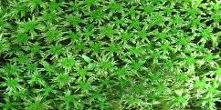
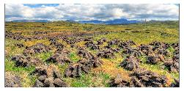
Change and Adapt 1: Moss and Climate Change
Moss species
Globally:12,000-15,000
UK: about 750
State of Nature Report 2023
Since 1970, bryophytes have reduced by 59%.
Increased distribution is only 26%.
One in five bryophytes are classified as threatened species in Great Britain.
Moss is abundant forests and wetlands. In wetlands moss stores carbon as peat.
Globally wetlands cover 3% of the planet, but store 30% of global carbon.
Impact of climate change is likely to dry out wetlands, releasing more carbon and reducing this carbon store.
Human impact
Large scale
Digging up peatlands to use in gardens or burnt to heat homes. Releases stored carbon. Urbanisation to meet population demands.
Small scale
Reducing space for nature with concrete and plastic grass. Overuse of herbicides and pesticides.
Climate change is happening at a rate faster than ever seen before.
Impact of current climate change
Predictions for Europe suggest:
Although mosses are fast dispersers and colonisers, they will not be able to keep up with the rate of climate change.
Only 30% of moss species will have adapted to the new conditions by 2050.
Overall loss of biodiversity in mosses, a large extinction event.
Burns et al. (2023)
Wetlands Trust
Zanatta et al. (2020)
Notes:
While bryophytes successfully back-colonized areas of suitable climate since the end of the last glacial maximum, 18,000 years ago39, our results suggest that, at best, ~30% of the species would be at equilibrium with their environment by 2050. This indicates that bryophytes are not equipped to track the very fast rates of ongoing climate change projected for the course of the next decades. Although recent evidence for synchronized increases in species richness towards high elevations and global warming points to rapid colonization potential of newly available habitats12, our results, together with other analyses investigating species-specific responses13,14,40, suggest that changes in diversity patterns tend to mask considerably the delays observed at the level of individual species. In fact, a growing body of evidence supports the idea that plant species spread rates are consistently expected to be much lower than the velocity of climate change11,33–35. This highlights the crucial role of integrating dispersal when attempting to predict future distribution ranges22–24, even in apparently highly dispersive organisms like bryophytes.

Slide 8
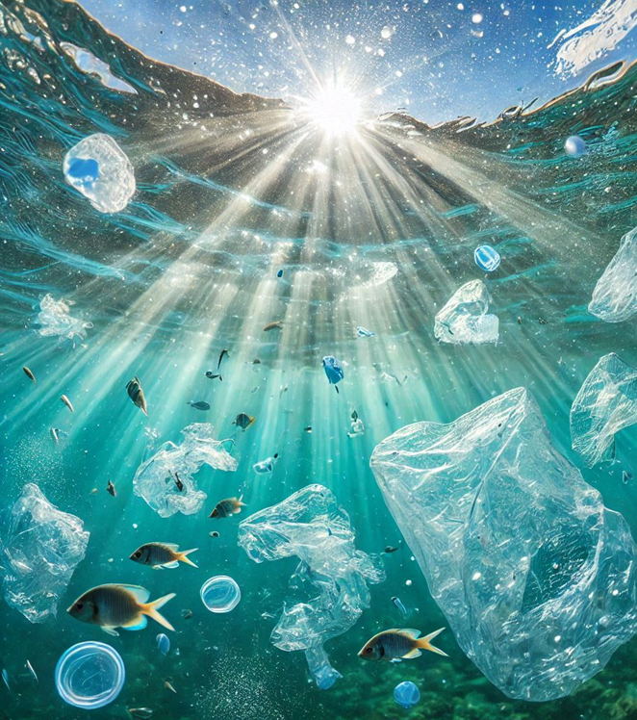
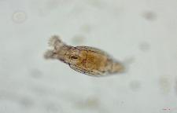
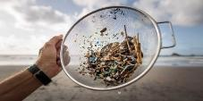
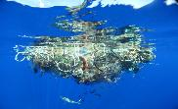
Change and Adapt 2: Rotifers and Microplastics
Rotifers
Around 2,200 species.
Most live in freshwater, but some are marine.
Most around 0.5 mm in length.
Distinctive adaptations: ‘corona’ and ‘trophi’ involved in filter feeding.
They can filter 100,000 times their own volume of water per hour.
Microplastics
Microplastics (MPs) are one micrometre long or less.
Sources: tyres, washing clothes, sewerage, plastic pellets used to make plastic items etc.
Impact: bioaccumulation in food chains, in marine life - blocks digestive systems, reduces reproductive success, harms soil health.
Case of microplastics and marine rotifers
When there are microplastics in the sea, marine rotifers accidently breakdown MPs into nanoplastics (NPs).
Impact of NPs on rotifers
The smaller the particle, the greater the uptake into the rotifer’s body.
Smaller particles have greater negative effects on rotifer life cycles including growth rate, digestion and reproductive success.
And a negative effects on future generations.
Li et al (2023)
Yu et al (2024)
Adaptions to plastic
Rotifers recover if grown in clean water
Wang et al (2023)
Plastic degrading bacteria found in the environment and the in guts of marine worms.
Zhao (2024)
The plastisphere
Microbes and meiofauna are colonising the plastisphere.
Bacteria, viruses, algae and tardigrades. Ecological change will occur, we are not sure how or to what extent.
Lacerda et al (2024)

Slide 9
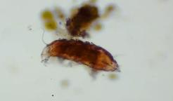
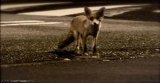
Change and Adapt 3: Urbanisation of tardigrades
Tardigrades
Less than 1 mm in length.
Live mostly in moss and lichens.
Some species can survive extreme conditions in their tun state.
Urban areas
Cities have high levels of pollutants including
Several tardigrade species can survive in moss and lichen in cities.
Common pollutants
Gases – nitrogen oxides, carbon dioxide /monoxide, ozone, heavy metals, oil and grease, microplastics, industrial chemicals, pesticides, and herbicides.
Urban sludge
An artificial substrate made up of urban waste.
de Albuquerque et al (2018)
Urbanisation
Human population:
>6000 billion by 2045
Urban areas are expanding significantly.
Urbanised animals include pigeons, foxes, sea gulls, squirrels are adapted to survive in cities.
Are tardigrades becoming urbanised?
It appears that there are some tardigrade species only found in urban substrates.
Gonzalez-Reyes et al (2000)
Case study in Salta City, Argentina.
Monitoring biodiversity and abundance of urban tardigrades.
The impact of an anthropause
COVID-19 Lockdown
During the anthropause, the species diversity and abundance of tardigrades increased in all 3 traffic areas.
González-Reyes et al (2024)
Traffic | Biodiversity | Abundance
Low | High | Medium
Medium | Medium | Medium
High | Low | High

Slide 10
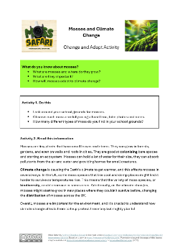
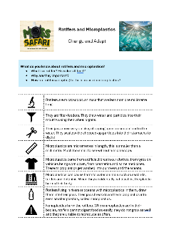

Resources for British Science Week 2025
All coming soon to
www.mosssafari.com
Editable:
Feel free to Change & Adapt!
Subscribe to www.mosssafari.com for free resources

Slide 11
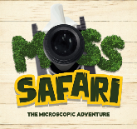

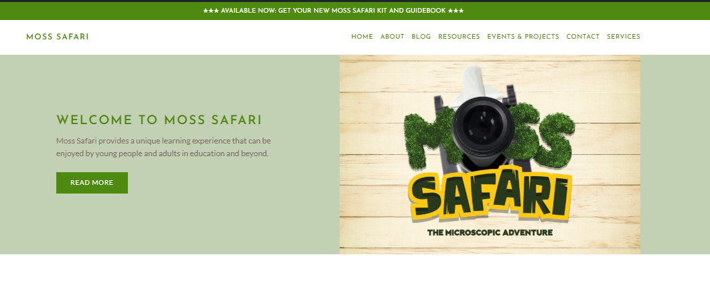
Doing a Moss Safari? Share with us!
www.mosssafari.com
Visit How to do a Moss Safari webpage
Subscribe to the website for free resources
Download the free Moss Safari BSW resources
Do your own Moss Safari using the Moss Safari resources
Send Moss Safari your pictures on social media
Send your Moss Safari pictures for our Gallery
Write a guest blog for Moss Safari

Slide 12

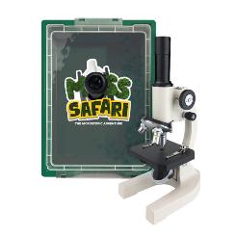
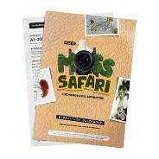
Thank you and feedback
Instant Feedback Welcome – use the QR or link below
Please don’t forget to mention Moss Safari in the
ASE Conference Feedback as well!
Find out about Moss Safari Kits
and Resource Booklets at www.mosssafari.com
https://forms.gle/eSZfe34yRpRY3Z8B7

