Slide 1
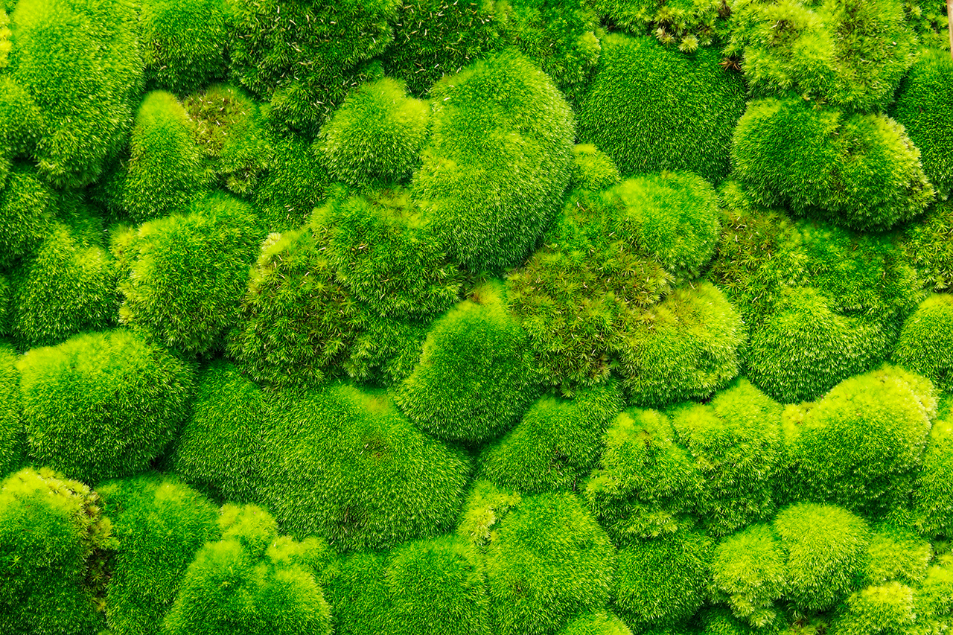
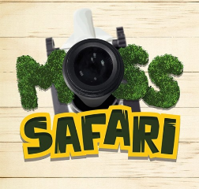

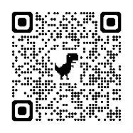
Moss Safari:
Behind the scenes
Dr Andy Chandler-Grevatt
TOP SECRET
For technicians only!
TechFest 2024
www.mosssafari.com

Slide 2
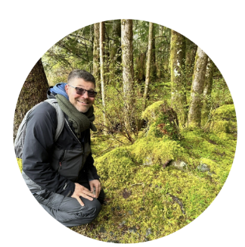
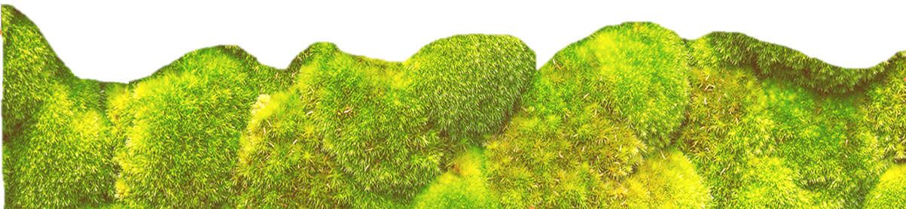
Dr Andy Chandler-Grevatt / Dr Moss
Quick introduction to Moss Safari
The tips and techniques for technicians
Mini Moss Safari expedition
Welcome to Moss Safari
Notes:
Evolution and inheritance
Pupils should be taught to:
recognise that living things have changed over time and that fossils provide information about living things that inhabited the Earth millions of years ago
recognise that living things produce offspring of the same kind, but normally offspring vary and are not identical to their parents
identify how animals and plants are adapted to suit their environment in different ways and that adaptation may lead to evolution

Slide 3

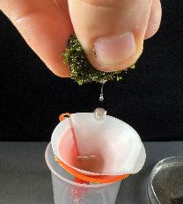
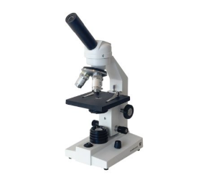
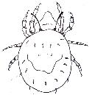




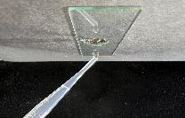
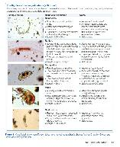
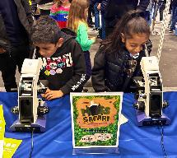
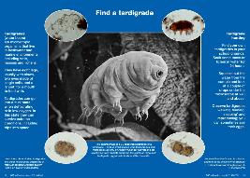
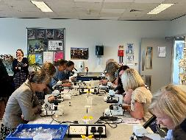
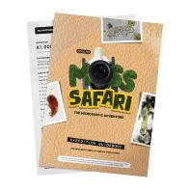
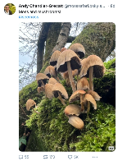
What is Moss Safari?
“I’ll never look at moss in the same way again”
“The simplest thing to do with a microscope”
Aims
Engagement with nature.
Promoting microscopy and making it accessible to all.
Inspire everyone to do STEM hobbies and careers.
The search for the microscopic Big Five (x40)
Education
Collaboration
Accessible resources
Outreach in schools
Public engagement
mite – nematode – rotifer – tardigrade – gastrotrich
Curriculum links and life stories (KS2-KS5)
Their lives in moss
→
In the ecosystem
→
Relevance to our lives
The Moss Squeeze: Soak → Squeeze → Observe

Slide 4
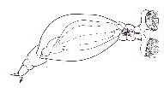

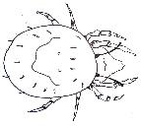
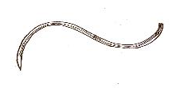
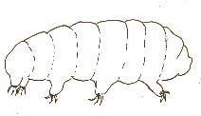
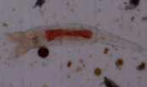
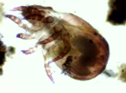

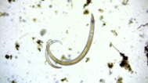
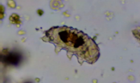
The Microscopic Big 5
Moss mite
Rotifer
Gastrotrich
Tardigrade
Nematode
Microscopic invertebrates

Slide 5
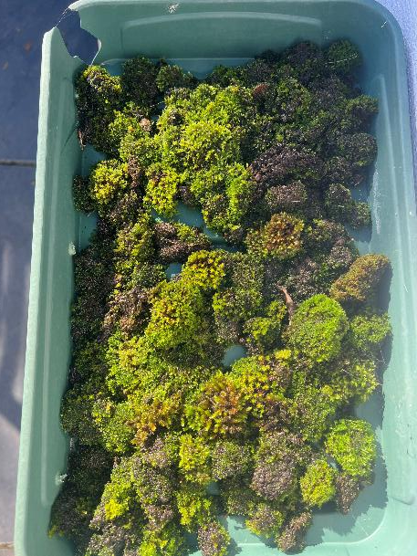
Tip: Moss collection
TOP SECRET
For technicians only!
Keep a seed tray in a shaded place.
Allow drainage.
Keep raised above the ground to protect from slugs and snails.
Add moss cushions and mats as you find them.
Can be used year-round. In warmer months soak for 24 hours minimum before observing.

Slide 6
Four techniques for collecting moss water
Pipette: suck and see
Basic moss squeeze
Moss squeeze and filter
Moss gravity collection

Slide 7
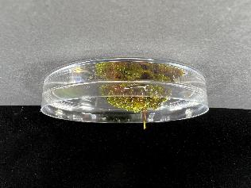
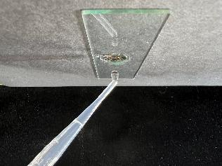
1. Pipette: suck and see
Place pipette tip on soaking moss.
Suck up water through the moss.
Hold pipette upright (tip down) for 30 seconds.
Place 2-3 drops onto the dimple slide and observe.
Great for quick, whole class Moss Safaris.
Very hit and miss

Slide 8
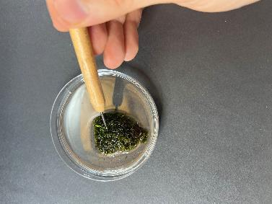

2. Moss squeeze
Soak moss
Squeeze moss cushion into a dish or (carefully) directly onto the slide.
Great for whole class Moss Safaris.
Can be messy. Must wash hands afterwards.
A bit hit and miss.

Slide 9
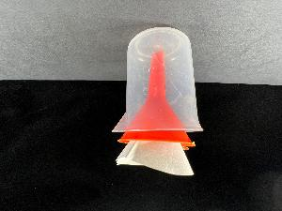
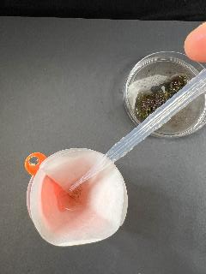

3. Moss squeeze and filter
Soak moss
Squeeze moss cushion into a filter paper and collect concentrated sample in a pipette
Great for whole class Moss Safaris. High hit rate.
Takes more time, can be messy.
Can do a pre-lesson batch.

Slide 10
4. Moss gravity collection
Takes time to set up and needs overnight to collect.
More complicated set up.
High yielding – high hit rate.
Great for preparing Moss Safari samples for several classes or events.

Slide 11


Let’s go on a Moss Safari!
Expedition information:
We will stop at interesting animals or plants.
We do not chase the wildlife!
Magnification x 40 (sometimes x 100).
Focussing takes time.
No guarantee we will see any of the Big Five, but we will see interesting things.
I’m still learning…
2 -3 drops of water from moss
Zig zag spotlight across a 15 mm well

Slide 12

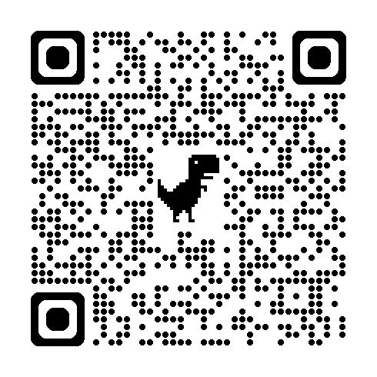
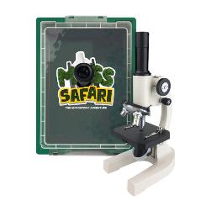
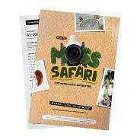
Thank you and feedback
Instant Feedback Welcome – use the QR or link below
Please don’t forget to mention Moss Safari in the
ASE Conference Feedback as well!
Find out about Moss Safari Kits
and Resource Booklets at www.mosssafari.com
https://forms.gle/eSZfe34yRpRY3Z8B7

Slide 13

GALLERY
Questions?

Slide 14
THANK YOU

Slide 15






Moss Safari Resources
https://vittaeducation.com/moss-safari/
DuraLab DF-100 Classic Monocular

