Slide 1
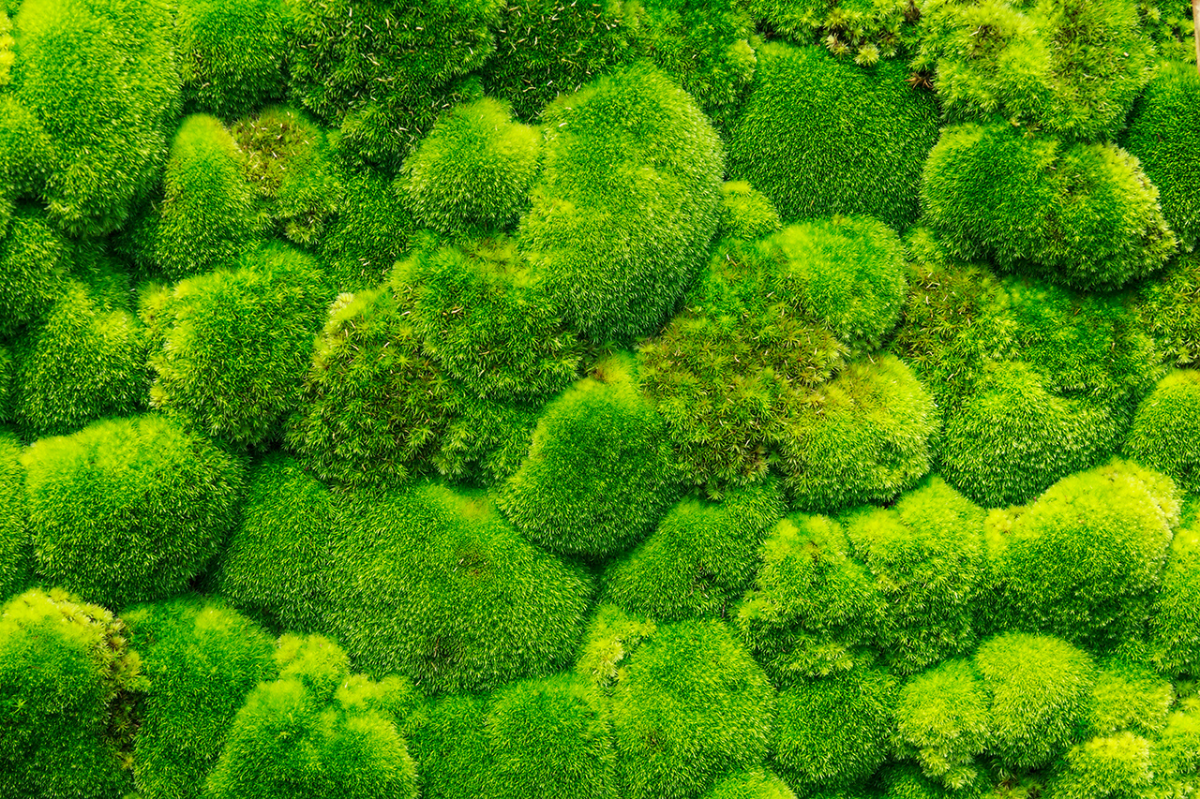



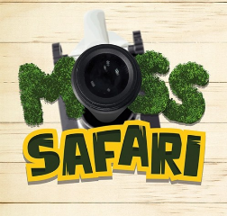
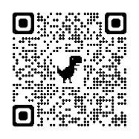

Moss Safari:
Behind the scenes
Dr Andy Chandler-Grevatt
TOP SECRET
For technicians only!
TechFest 2024
www.mosssafari.com

Slide 2
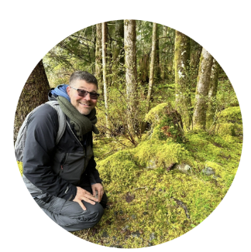
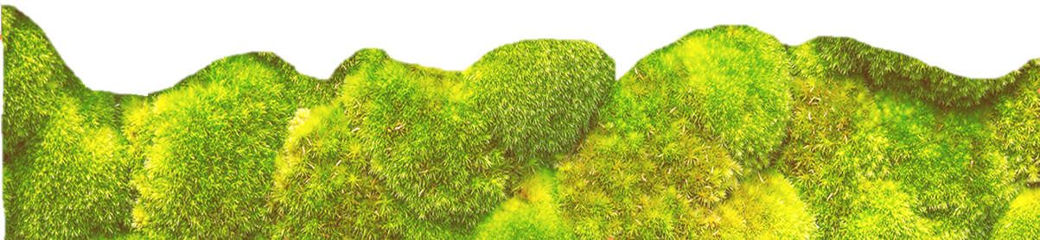
Dr Andy Chandler-Grevatt / Dr Moss
Quick introduction to Moss Safari
The tips and techniques for techs
Mini Moss Safari expeditions
Welcome to Moss Safari
Notes:
Evolution and inheritance
Pupils should be taught to:
recognise that living things have changed over time and that fossils provide information about living things that inhabited the Earth millions of years ago
recognise that living things produce offspring of the same kind, but normally offspring vary and are not identical to their parents
identify how animals and plants are adapted to suit their environment in different ways and that adaptation may lead to evolution

Slide 3

Moss Safari
“The simplest thing to do with a microscope”
“I’ll never look at moss in the same way again”
Aims
Engagement with nature
Promoting microscopy – making it accessible
Building Science Capital for STEM hobbies and careers

Slide 4
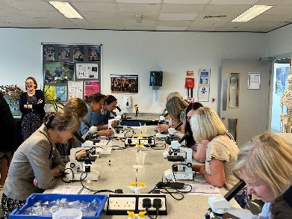
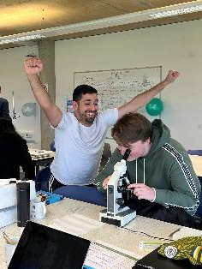
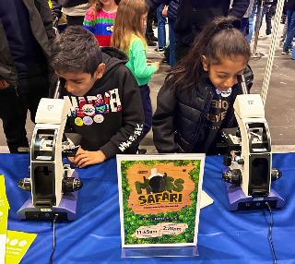
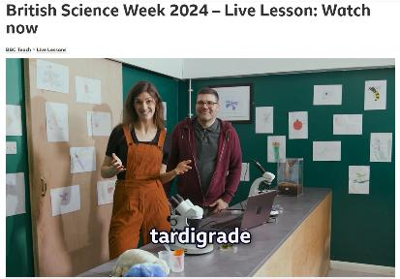
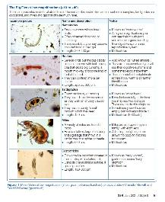
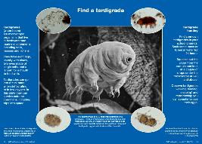

Mass Safari Activities
Education
Collaboration
Accessible resources
Outreach with primary & secondary schools
Public engagement

Slide 5
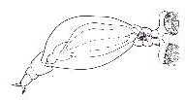

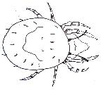
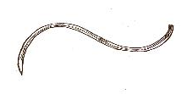
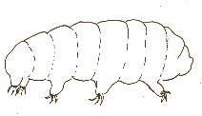
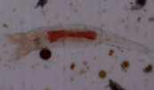
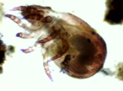

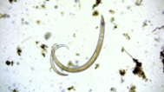
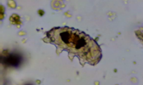
The Microscopic Big 5
Moss mite
Rotifer
Gastrotrich
Tardigrade
Nematode
Microscopic invertebrates

Slide 6
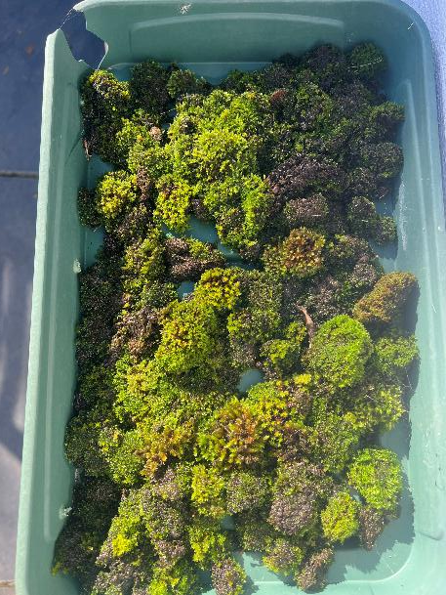
Tip: Moss collection
TOP SECRET
For technicians only!
Keep a seed tray in a shaded place.
Allow drainage.
Keep raised above the ground to protect from slugs and snails.
Add moss cushions and mats as you find them.
Can be used year-round. In warmer months soak for 24 hours minimum before observing.

Slide 7
Four techniques for collecting moss water
Pipette: suck and see
Basic moss squeeze
Moss squeeze and filter
Moss gravity collection

Slide 8
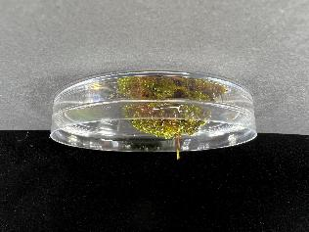
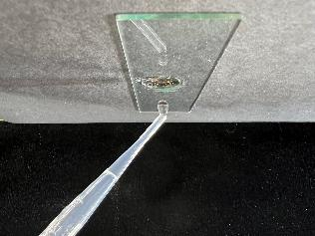
1. Pipette: suck and see
Place pipette tip on soaking moss.
Suck up water through the moss.
Hold pipette upright (tip down) for 30 seconds.
Place 2-3 drops onto the dimple slide and observe.
Great for quick, whole class Moss Safaris.
Very hit and miss

Slide 9
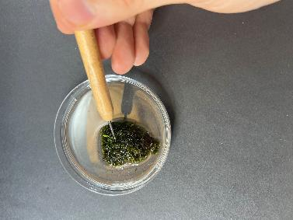
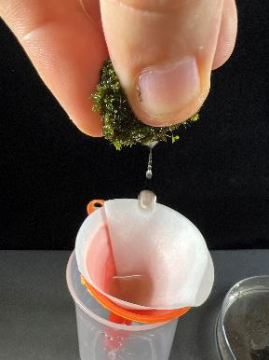
2. Moss squeeze
Soak moss
Squeeze moss cushion into a dish or (carefully) directly onto the slide.
Great for whole class Moss Safaris.
Can be messy. Must wash hands afterwards.
A bit hit and miss.

Slide 10
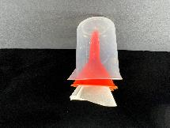
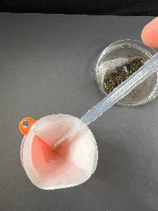

3. Moss squeeze and filter
Soak moss
Squeeze moss cushion into a filter paper and collect concentrated sample in a pipette
Great for whole class Moss Safaris. High hit rate.
Takes more time, can be messy.
Can do a pre-lesson batch.

Slide 11
4. Moss gravity collection
Takes time to set up and needs overnight to collect.
More complicated set up.
High yielding – high hit rate.
Great for preparing Moss Safari samples for several classes or events.

Slide 12


Let’s go on a Moss Safari!
Expedition information:
We will stop at interesting animals or plants.
We do not chase the wildlife!
Magnification x 40 (sometimes x 100).
Focussing takes time.
No guarantee we will see any of the Big Five, but we will see interesting things.
I’m still learning…
2 -3 drops of water from moss
Zig zag spotlight across a 15 mm well

Slide 13
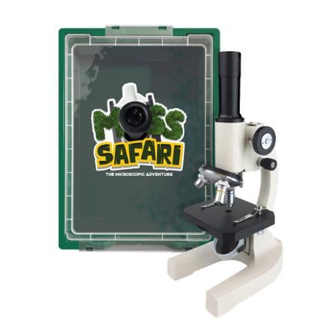
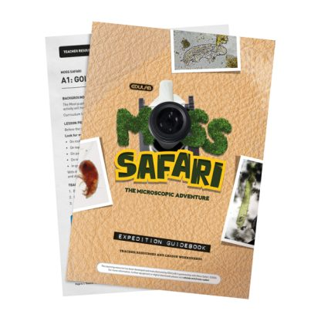
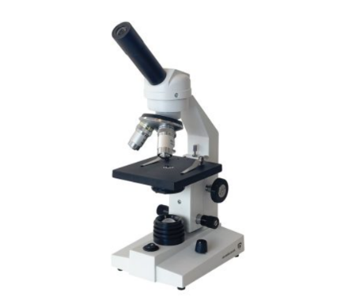
Moss Safari Resources
https://vittaeducation.com/moss-safari/
DuraLab DF-100 Classic Monocular

Slide 14

GALLERY
Questions?

Slide 15
Course evaluation
Please complete our evaluation form.
You will receive a link to the form by email from sciencehub@hertsandessex.herts.sch.uk
The form takes a few minutes to complete. Your feedback is important to us and:
  helps to provide evidence for your own performance reviews
  receive your course certificate of course completion
  feedback for us to integrate into our courses

Slide 16
THANK YOU

