Slide 1

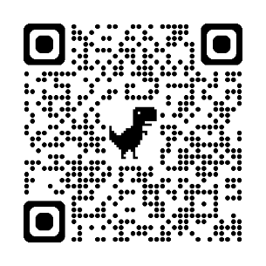
Microscopes as Science Capital? Challenges and Opportunities
Dr Andy Chandler-Grevatt
Senior Lecturer in Science Education, University of Brighton
Founder, Moss Safari
a.chandlergrevatt@brighton.ac.uk
www.mosssafari.com
Notes:
Are microscopes overlooked and undervalued in school science? In this session Andy will present four years of data from trainee science teachers on out of school experiences of using microscopes and the challenges of and opportunities for using microscopes in the classroom. Then, Andy will present the argument that microscopes are a gateway instrument to increasing Science Capital and lifelong engagement in STEM activities, as a hobby or as a career. Therefore, early positive informal and formal experiences of using a light microscope at home and at school should be optimised to improve engagement with STEM and uptake of STEM careers.
This will be followed by small group discussion of key questions and an opportunity to critique and develop these ideas.
Outcomes for delegates include engagement with new research data on the challenges and opportunities of using microscopes in secondary school and at home, considering the evidence within the frame of Science Capital, and contributing to discussion on experiences, perspective and solutions. Andy hopes that delegates will be able to engage in lively and thought-provoking conversation that could lead to real changes in practice.

Slide 2

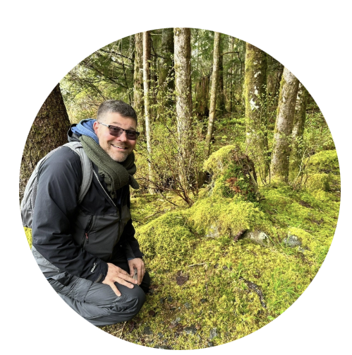
BERG at ASE 2025
Session outline
Background: What is Moss Safari?
A case for microscopes as Science Capital
A hypothesis based on exploratory evidence
A potential project
Discussion and feedback

Slide 3
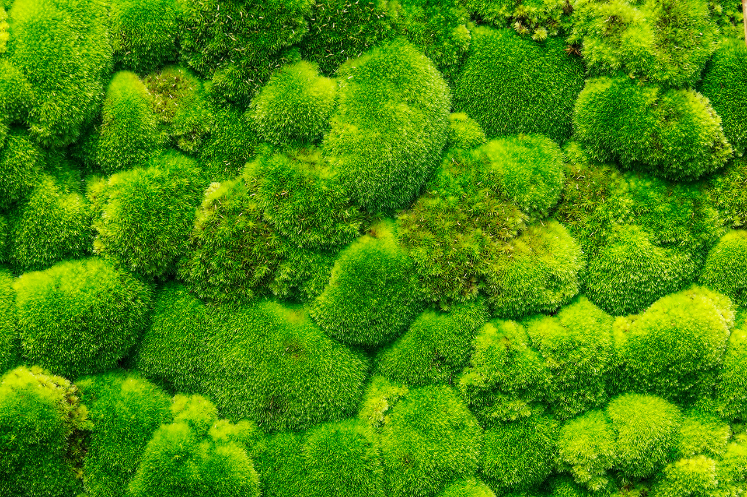
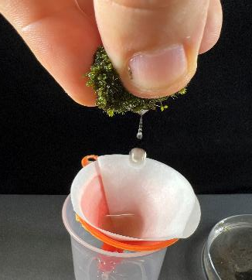
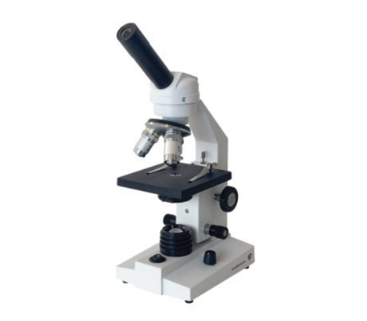
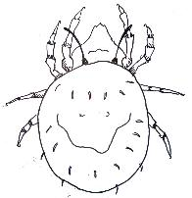




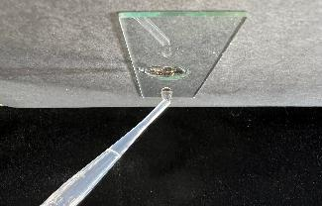
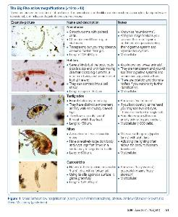
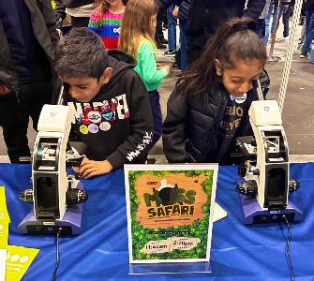
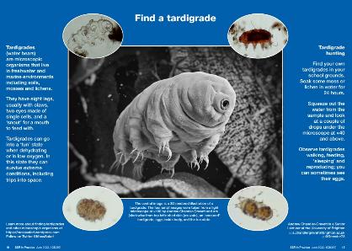
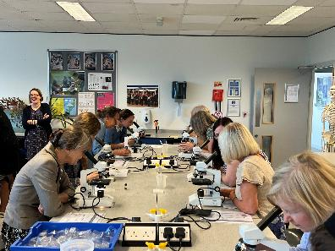
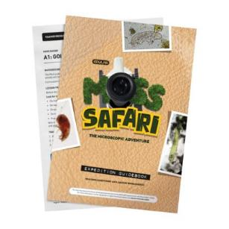
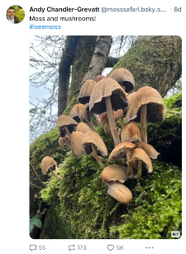
What is Moss Safari?
“I’ll never look at moss in the same way again”
“The simplest thing to do with a microscope”
Aims
Engagement with nature.
Promoting microscopy and making it accessible to all.
Inspire everyone to do STEM hobbies and careers.
The search for the microscopic Big Five (x40)
Education
Collaboration
Accessible resources
Outreach in schools
Public engagement
mite – nematode – rotifer – tardigrade – gastrotrich
Curriculum links and life stories (KS2-KS5)
Their lives in moss
→
In the ecosystem
→
Relevance to our lives
The Moss Squeeze: Soak → Squeeze → Observe

Slide 4
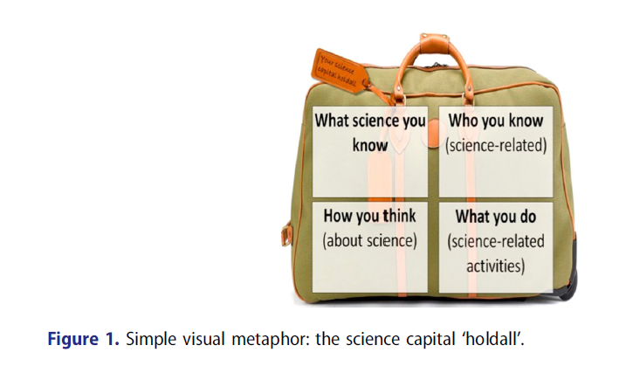
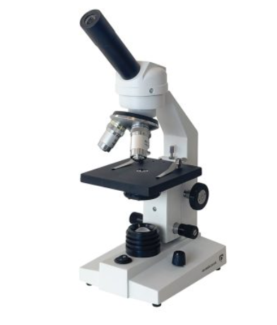
What is Science Capital?
‘Science capital as what may help transform positive attitudes and interest in science into decisions and choices – actions – that make future science participation more likely.’ p.2443
Jennifer DeWitt, Louise Archer & Ada Mau (2016) Dimensions of science
capital: exploring its potential for understanding students’ science participation, International
Journal of Science Education, 38:16, 2431-2449, DOI: 10.1080/09500693.2016.1248520

Slide 5
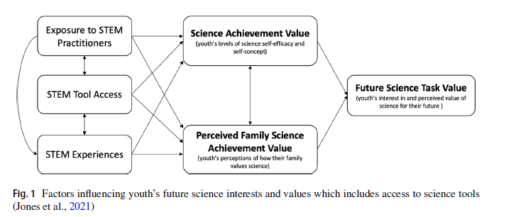
Jones, M.G., Chesnutt, K., Ennes, M., Mulvey, K.L. and Cayton, E., 2021. Understanding science career aspirations: Factors predicting future science task value. Journal of Research in Science Teaching, 58(7), pp.937-955.
Existing Research

Slide 6
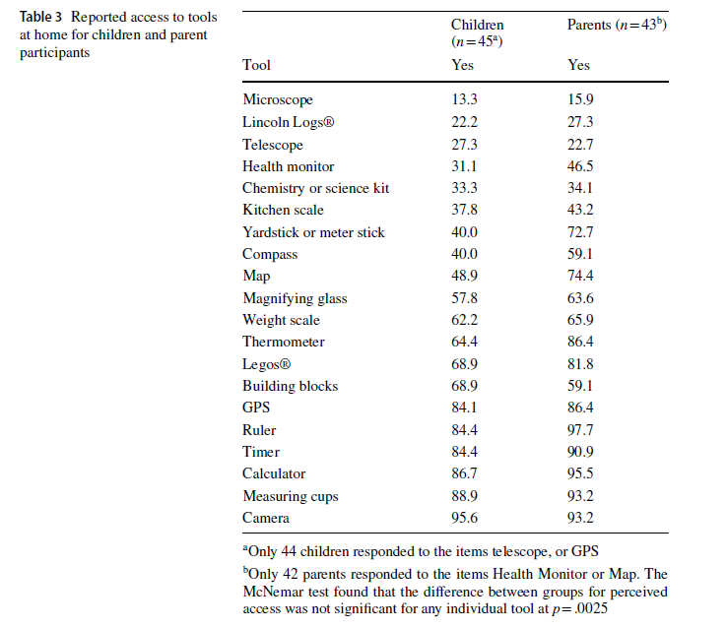
Ennes, M.E., Jones, M.G., Childers, G.M., Cayton, E.M. and Chesnutt, K.M., 2023. Children and parents’ perceptions of access to science tools at home and their role in science self-efficacy. Research in Science Education, 53(4), pp.671-687.
Existing Research
In the US, access to microscopes as lowest percentage for both children and parents

Slide 7
Opportunities for microscope use in lessons
KS3: Cells and microscopes: Onion skin cells
Working Scientifically
use appropriate techniques, apparatus, and materials during fieldwork and laboratory work, paying attention to health and safety
Calculating size from magnification.
KS3: Cells and microscopes: Human Cheek cells
KS3: Unicellular organisms (amoeba and euglena)
KS3: Reproduction: pollen tube growth
Do all pupils actually do all of these?
KS3: Physical Changes - Brownian motion in gases
KS4: Use a light microscope to observe, draw and label biological specimens (Required Practical)
Department for Education (2014) National Curriculum for England. Science Keys Stage 1-4.

Slide 8
The microscope: Opportunities & Challenges
Early years
Primary
Secondary
Post 16
Tertiary
Adulthood
Having microscopes used around them at home e.g. hobbies, amateur, professional. Having family talk about microscopy.
Having toy microscopes
Having and using own microscope
Having and using microscopes at home or at work
School experiences using good quality microscopes
College experiences using good quality microscopes
University/training experiences using good quality microscopes
No exposure to microscopes at home
No talk about microscopes
No family role models using microscopes
No use or ownership of a microscope
No school experiences of microscopes
Second hand experiences
Use of poor-quality microscopes
Rushed experiences
Paired experiences
No ownership
No meaningful experiences
Rough estimate:
Pupils will have approx. one lesson per year using a microscope during their five years in secondary education. Approx 5 hours.

Slide 9
Evidence for barriers
6. What do you think are the barriers to using Moss Safari in your teaching?
Selection of microscope related comments
(n=58 trainee science teachers from 3 cohorts)
Time (in lessons)
(Teacher) confidence using a microscope
Access to microscopes, camera and microscope equipment.
(Teacher) knowledge of using a microscope
Covid – change in practical approaches
(Teacher) dealing with uncertainty – troubleshooting
Lack of time/support/knowledge of science technicians’
Poor quality microscopes
Lack of extra curricular time / opportunities

Slide 10
Summary
Issues with microscope use at school
Organisational | Teacher | Student
Curriculum expectations Time in lessons Extracurricular time Cost of buying microscopes Cost maintaining microscopes Time maintaining microscopes Skills for maintaining microscopes | Curriculum opportunities Experience of using microscopes Confidence using a microscope Skills using microscopes Skills teaching microscopes Access to good quality microscopes | Access to good quality microscopes Lack of time to use a microscope Lack of ownership of equipment and investigations using microscopes Lack of extended projects Lack of extracurricular opportunities

Slide 11
Hypotheses
Secondary school students have limited opportunities to use a microscope (possibly one lesson per year over five years). This is unlikely to change.
These experiences are often procedural, rushed and use inadequate microscopes, leading to disengagement with microscopy and related STEM careers.
Classroom experiences could be improved with quality teacher training opportunities and technician support/training.
Extra curricular opportunities for using microscopes could be effective with access to quality microscopes, accessible resources and teacher training. A five week project could double the time that students have in lessons with microscopes).
Improving teacher and technician training, providing access to good quality microscopes and providing quality extra curricular opportunities will improve science capital related to microscopy and STEM interest and careers in the secondary school setting

Slide 12
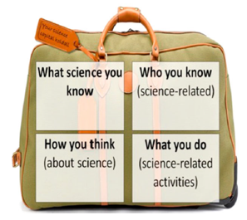
Jones, M.G., Chesnutt, K., Ennes, M., Mulvey, K.L. and Cayton, E., 2021. Understanding science career aspirations: Factors predicting future science task value. Journal of Research in Science Teaching, 58(7), pp.937-955.
Opportunities using the Jones et al model
Short and medium term projects.
Badges, certificates and awards
Teachers, technicians, visitors using microscopes
Access to good quality microscopes
Recognition from schools, universities and learned societies.
Citizen science opportunities.
Best quality classroom and extracurricular experiences

Slide 13
Similar or useful projects/models
Cohen, J.I., 2021. Applications of microscopy in science education: gifted youth, public school, and the next-generation science standards (NGSS). Journal of Biological Education, 55(5), pp.518-527.
Hale, J., Harkess, A., and Könyves, K. 2024. The Jersey Daffodil Project: Integrating nanopore sequencing into classrooms improves STEM skills, scientific identity and career development. Plants, People, Planet 6, no. 6: 1293-1298.
Gąsiorek, P., Sørensen, M.V., Lillemark, M.R., Leerhøi, F. and Tøttrup, A.P., 2024. Massive citizen science sampling and integrated taxonomic approach unravel Danish cryptogam-dwelling tardigrade fauna. Frontiers in Zoology, 21(1), p.27.

Slide 14
The ambition and plan
1. SURVEY
Establish the quality of microscopes and experiences with microscopes in secondary schools
State of the nation
2. ACERTAIN IMPACT
Moss Safari outreach with 15 microscopes 3 x primary and 3 x secondary schools
3.ROLL OUT
Funders to provide quality microscope clusters.
Quality teacher training and resources for extra curricular activities

Slide 15
Online survey of school technicians (?) of state schools in England (or 4 nations).
Questions
  Considering each year group / phase
  Number of microscopes
  Types of microscopes
  Age, quality, state of repair
  How often used
  Technician skills at looking after microscopes.
  Teacher skill at using microscopes
Outcomes
  Recommendations
  Source funding to improve local school microscopes (industry?)
  Teacher and technician support
Funding and support avenues:
University of Brighton (internal)
Association for Science Education
Royal Society of Biology
Royal Microscopy Society
Pixel Science team
British Science Association
Royal Entomological Society (RES)
Others
Discussion
Thoughts on:
A. The concept: Microscopes as science capital
B. The Hypotheses:
Improving teacher and technician training, providing access to good quality microscopes and providing quality extra curricular opportunities will improve science capital related to microscopy and STEM interest and careers in the secondary school setting
C. The Ambition:
Survey, Outreach, Roll out
D. A focus on the survey:
What to include?
Who would support?

Slide 16
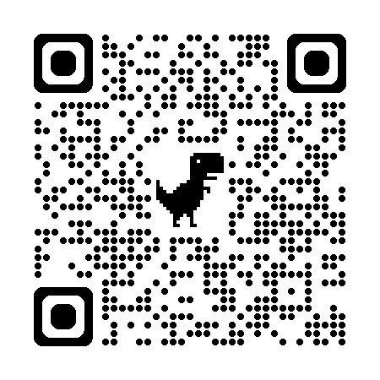
Thoughts welcome
PowerPoint Available here:
Events and Projects
Dr Andy Chandler-Grevatt
a.chandlergrevatt@brighton.ac.uk
www.mosssafari.com

Slide 17
Further Reading
Chandler-Grevatt, A. (2021). Moss Safari: Inspiring Interest in Nature under the Microscope. School Science Review, 102(381), 49-55.

